Slide 1
Network 2030 Vision
Roller Coaster Presentation
>1 SPM (slide/minute)
CUSTOMER RELEASE,
ASSUMPTION OF RISK,
WAIVER OF LIABILITY,
AND INDEMNIFICATION
AGREEMENT
…......................................
Sign above line
Delivering the Promise of Future Media by 2030
Toerless.Eckert, Kiran.Makhijani @futurewei.com, Santa Clara, CA, USA
AWE EU pre conference Workshop: The Challenge of Spatial Computing
16 October 2019, München, Germany

Slide 2

Imagine applications in 2035
One fine day… Feb 2018
Future Scenarios will Blend Virtual and Real Worlds Seamlessly.
Hypothetically speaking,
Assume we want to design a new
Network and its protocols
that would support the world in 2035.
What would be your
Best use cases and market drivers?
Service Mashups
(that blend networking and other technologies, and that integrate the virtual and the physical world)
AR/VR HMDs limiting to natural experience
See eg: failure of 3D@home.
Holograms could become
Core Digital Actors
What networks would Holograms need ?
Multi-source, multi-destination
problem
Networked AR/VR? Holograms with tactile sensors
Notes:
We have reached the limit of what we could do with 2D; AR/VR Head mount devices are cumbersome – prohibitive to natural experience; New media technologies make Digital Holograms possible

Slide 3
Holographic Digital Actors
Start with
Insert holograms into real environments
Allow experiences to develop without having to use HMDs.
First steps: Placement of Digital Actors in a Physical World
Milgram and Kishino defined Reality-Virtuality Continuum
Holographic Digital Actors: Naturally - grounded in the real world - Life sized or resizable - Responsive, but not alive

Slide 4
Holo-presence Holographic Communication Use case
Use-case: Digital Actor Single point cloud holographic object in a real scene
Telepresence using Hologram.
It is the only digital object in the scene,
remaining entities are real.
Ideally, Alice has respective setup.
Meeting room view + Alice’s hologram
Alice’s view with Meeting room as hologram

Slide 5
Holographic Media Engine
**800K points = 1000 Mbps.
Evolution of Holograms
from Diffraction patterns to Light field models.
*Raw LF: 500 GB/s
Still (single frame)
Holographic datasets comprise of giga (or tera) bytes of uncompressed data.
Computation times for codecs can be restrictively high (~50ms)
Compression schemes known to improve with adoption, but no good predictions for “final” rates.
*Hybrid : 300 MB/s
*2D LF : 30 MB/s
source: *https://mpeg.chiariglione.org/sites/default/files/events/08_KARAFIN_LightFieldLab_MPEGWorkshopLB_v01.pdf
**https://mpeg.chiariglione.org/sites/default/files/events/05_MP20%20PPC%20Preda%202017.pdf

Slide 6
Streaming
Traditional Networking
With end to end intelligence in order to support holographic streams.
Trade offs between
How much can we transmit?
The resolution or quality?
How much latency is acceptable?
But there’s a limit:
Throughput is not exactly bandwidth.
E2E Latency > network propagation delay.
THROUGHPUT
Higher the Better
LATENCY
Shorter the Better

Slide 7
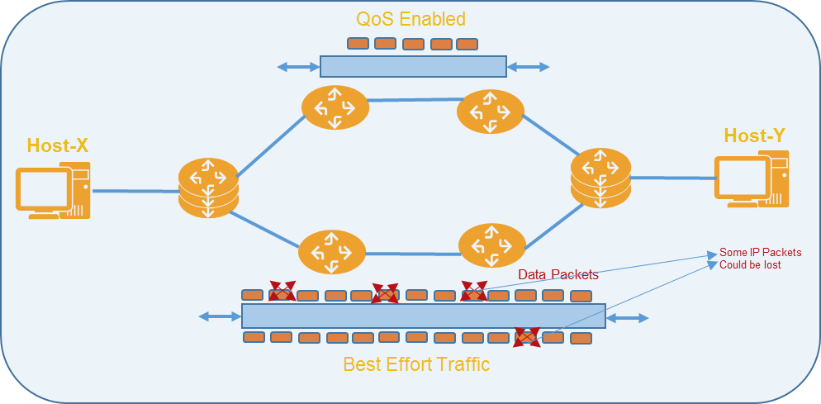
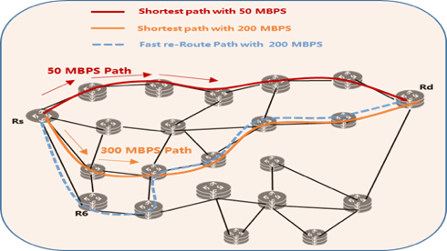

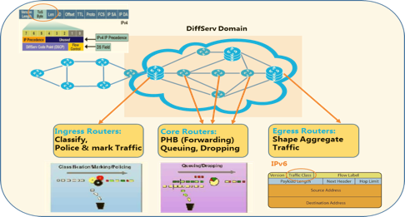
(Beyond) Internet Capabilities Today
Available Services Internet
Streaming == Abuse of web-caches
Traffic Engineering ==
Capacity Engineering
Internet: Best Effort
“Best Effort” Per-Hop Behavior (PHB)
ECN / AQM (maybe)
“Shortest Path” routing
Throughput / Priority Guarantees
Latency Guarantee (path/queuing)
No-Loss guarantees
Jitter
Beyond Internet:
Differentiated / (Integrated) Services
Beyond Internet
Fragmented, non-ubiquitous, ONE-OFF peer2peer maze of not-well-working services options. E.G.: biggest OTT provider get preferential treatments in network.

Slide 8
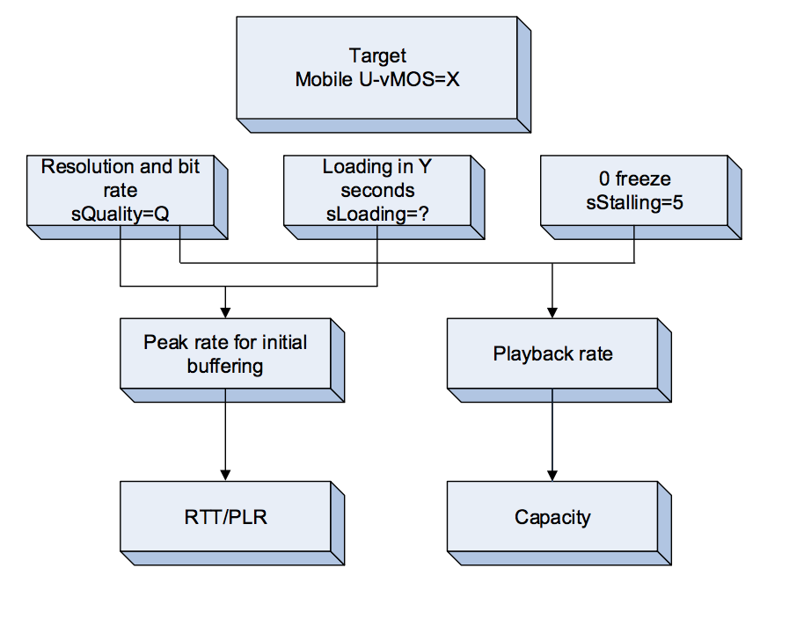
Mean Opinion Scores (MOS) “User experience” vs. Application/codec vs. network behavior (throughput, loss, latency)
Use case:
On-demand, High Resolution Home/Mobile Video
Initial , intermittent buffering
Probability / periodicity of non-congestion loss (NCL) Random (bit /packet errors) vs. Burst (outage) loss
Likelihood to conceal NCL (codec dependent) Ability to correct NCL (FEC, retransmissions)
Normal/Ideal quality (throughput)
Quality Variation (throughput variation) Frequency, fine-grained (concealed)
Congestion Loss (*YUCK*), Self-Friendly-ness
Example, Simple Mean Opinion Score
*Source: https://www.huawei.com/~/media/CORPORATE/PDF/white%20paper/Technical-White-Paper-on-Mobile-Bearer-Network-Requirements-for-Mobile-Video-Services

Slide 9
The troubles with throughput
Use case: Any Application
What is (Internet) throughput fairness ? “all flows are created equal” ??? E.g.: competing 4K TV and Smartphone
How to achieve fairness ? Path-RTT, transport-protocol-aggressivness
Guarantees ? Absolute Reservation == scale issues Relative throughput easier !!
Limited by Loss and Capacity: Higher performance requires lower loss or higher overhead
Higher the Better ?!
*Source: https://www.huawei.com/~/media/CORPORATE/PDF/white%20paper/Technical-White-Paper-on-Mobile-Bearer-Network-Requirements-for-Mobile-Video-Services

Slide 10
The Edge: Scale, Latency and Control Loops
Use case:
Live event feed/Real-time interactive, immersive gaming / remote-operations
Shorten control loop RTT.
Improve interactive experience (MOS!).
scale computational power for decoding / rendering (eg: different views)
How to control variability (throughput/latency)
Deterministic ?
High-Precision-Communications ?

Slide 11
High-Precision Communications
Use case:
Latency sensitive streaming, control-loops
Let applications manage network latency (queuing, buffering)
End-to-end min..max latency control
Stateless == per-packet
Avoid scale limits of network flow-awareness
With/without (bandwidth) reservations E.g: dynamic adjust throughput, but keep low-latency
On-time: Delay early packets Reduces application side buffering / jitter
In-time Guarantees
On-time Guarantees

Slide 12
Coordinated Communications
Use case:
Synchronized Multi-Part Remote Collaboration
Synchronized latency experience “Why can player 3 shoot /kill faster?”
(lowest RTT to server)
In-network latency fairness (vs. clients faking RTT)
Aggregate Network Resource Management
“Get N Gbps for 2 hours, split across parties as you like”
Scale optimizations with guarantees
Multicast: in-network replication to parties
Incast: Many to “virtual/cluster” one

Slide 13






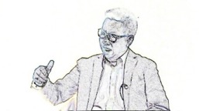

Qualitative Communications
Use case: Scalable Gradual management of quality
Layered/Object media codecs (e.g.: MPEG SVC)
Network awareness of Quality
Mapping to different per-packet network resources
E.g.: congest/(discard) highest-quality level first
Redundancy:
L3 In-network redundancy (FEC) insert/remove
From flows to packets:
When bitrates increase but not packet rates E.g.: Optical Switched Networks => huge packets
Packet-Chunks, tail-discard / congest / recover
Noisy link
Congested Node
Congested Node
Congested Node
Qualitative Packet
IP HDR

Slide 14
Holographic Streaming
New network services
New service aware packetization techniques, perhaps supported by new media formats
With new capabilities available, new formats for huge data sets can be modeled based on network-friendly metadata.

Slide 15
Full Stack Composition / Collaboration
Challenges (examples)
In-network capabilities
Variability bandwidth
Loss of connectivity
Trade offs between how much to compress and affordable delays.
Metadata to identify key pieces of environmental data.
FOV is only 1/5 of the scene. Bandwidth is wasted.
Currently no way to measure Quality (MoS) etc…
Provide metadata to network to receive desired experience.
Provide indication of time information.
Enabling in network qualitative techniques to resize, adapt surface textures.
Disaggregate key pieces of environmental data, e.g. different planes as different flows.
Coordinate fairness over heterogeneous links.

Slide 16
Future Media / Senses
Teleportation =
Holopresence + Sensual Information
Intuitive interactions
(Spatial Compute)
Natural interactions
(Teleportation)
Source: *https://www.itu.int/en/ITU-T/Workshops-and-Seminars/20190218/Documents/Rahim_Tafazolli_Presentation.pdf

Slide 17
Are we ready for the year 2030+? No, absolutely not!
Networking 101:
No significant fundamental changes for networks beyond “Best Effort”
Precision of time in services
Industrial Control
Autonomous Driving
Tactile Internet
MPLS ~= traffic engineering and VPN RSVP-TE can provide guaranteed services
IPv6/SRv6 increase the addressing space/overhead No change to QoS over IPv4
SR-MPLS/SR-v6 revives 1980’th source routing Optimized for capacity management
SDN is a new word for network management (provisioning/monitoring/validation)
VNF/NFV are software-ized routers/switches Rarely micro-services/cloud-native
Holographic Media
Real-time high-throughput streaming
Coordination of different streams
ManyNets Infrastructure
Space Internets
Private Internet
Unresolved Regulatory barriers
Moving beyond best effort
Premium Services
Lossless networking
Rich Access Technology
Gbps/Tbps access enabled by 5G/B5G and Surface Wave

Slide 18
Vision Network 2030
Holographic Society and Industry
2D
3D
Gbps
Tbps
2 Senses
5 Senses
MS
Sub-MS Latency
New Media
Network 2030
Next wave of
Internet Innovations
OneNet ManyNets
Mbps Gbps/Tbps Access
Computing in Networks
New
Services
New
Infrastructures
Lossless Networking
High-Precision Communications
Holographic Type Communications
Converged Terrestrial and Space
Fidelity and Trust
Federated Networks

Slide 19
Summary
New Network Capabilities
High-Precision (time-based services)
Qualitative service to manage throughputs
Coordinated services for single view of virtual worlds
Collaboration for new network-friendly media formats
Mechanisms to disaggregate volumetric data sets
Lots of metadata support.
Future Media Enablers/Market Drivers
Multi-sensory
Teleportation
Spatial Compute
Elements of Network 2030
Holographic and Future Media Communication
Packetization
Holographic Teleport
Spatial Compute

Slide 20
Publications and Talks
Concepts
A New Way to Evolve the Internet, A Keynote Speech at IEEE NetSoft 2018, Montreal, Canada, June 2018
What if we reimagine the Internet?, A Keynote Speech at IEEE ICII 2018, Bellevue, Washington, USA, Oct 2018
Framework and Architecture
A New Framework and Protocol for Future Networking, ACM Sigcomm 2018 NEAT Workshop, Budapest, August 20, 2018
New IP: Design for Future Internet with New Service Capabilities Envisioned, IEEE ICC Industry Tutorial, 2019
Market Drivers and Requirements
Towards a New Internet for the Year 2030 and Beyond, ITU IMT-2020/5G Workshop, Geneva, Switzerland, July 2018
Network 2030: Market Drivers and Prospects, ITU-T 1st Workshop on Network 2030, New York City, New York, October 2018
Next Generation Networks: Requirements and Research Directions, ETSI New Internet Forum, the Hague, the Netherlands, October 2018
The Requirements for the Internet and the Internet Protocol in 2030, ITU-T 3rd Workshop on Network 2030, London, Feb 2019
New Technologies
Preferred Path Routing – A Next-Generation Routing Framework beyond Segment Routing, IEEE Globecom 2018, December 2018
Flow-Level QoS Assurance via In-Band Signaling, 27th IEEE WOCC 2018 , 2018
Using Big Packet Protocol Framework to Support Low Latency based Large Scale Networks, ICNS 2019, Athens, 2019
Use Cases and Verticals
A Novel Multi-Factored Replacement Algorithm for In-Network Content Caching, EUCNC 2019, Valencia, Spain
Distributed Mechanism for Computation Offloading Task Routing in Mobile Edge Cloud Network, ICNC 2019, Honolulu, USA
Enhance Information Derivation by In-Network Semantic Mashup for IoT Applications, EUCNC 2018, Ljubljana, Slovenia
Latency Guarantee for Multimedia Streaming Service to Moving Subscriber with 5G Slicing, ISNCC 2018, Rome, Italy

Slide 21
References
Holographic content considerations methods for efficient data transmission and content creation methodologies
Point Cloud Compression in MPEG MP20 Workshop Hong kong 2017
Keynote: the near future of immersive experiences: where we are on the journey, what lies ahead, and what it takes to get there.
Architectures and codecs for real-time light field streaming journal of imaging science and Technology , January 2017
A Dynamic Compression Technique for Streaming Kinect-Based Point Cloud Data (2017 International Conference on Computing, Networking and Communications (ICNC): Multimedia Computing and Communications)
Technical White Paper on Mobile Bearer Network Requirements for Mobile Video Services.
On the Support of Light Field and Holographic Video Display Technology, Light Field Lab, Inc., San Jose, CA. “The road to immersive communication,” Proceedings of the IEEE, vol. 100, Apr. 2012.

Slide 22
Thank You
Comments, Curious, Questions?
toerless.eckert, kiran.makhijani @Futurewei.com
ITU-T FG-NET-2030
https://www.itu.int/en/ITU-T/focusgroups/net2030/Pages/default.aspx

